Slide 1
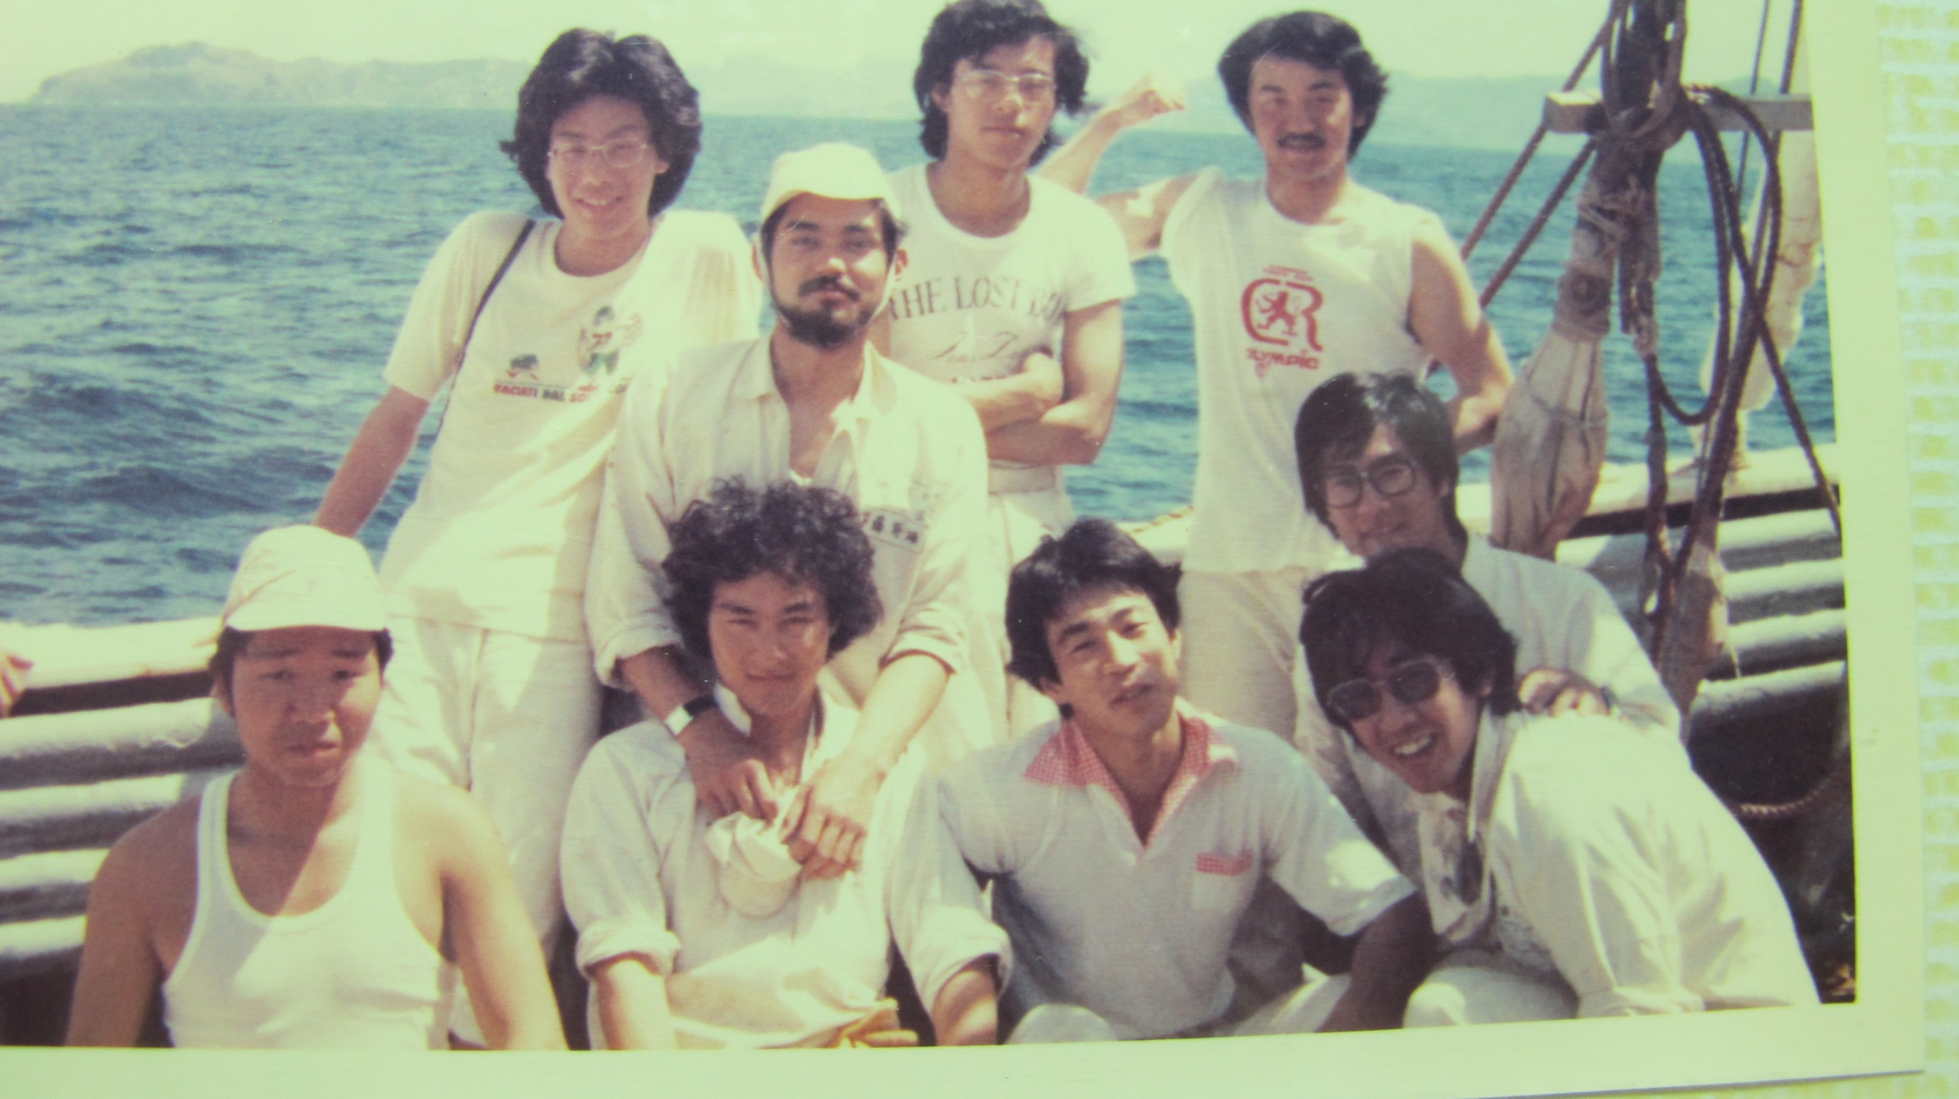
Editor: E.hayasaka

Slide 2
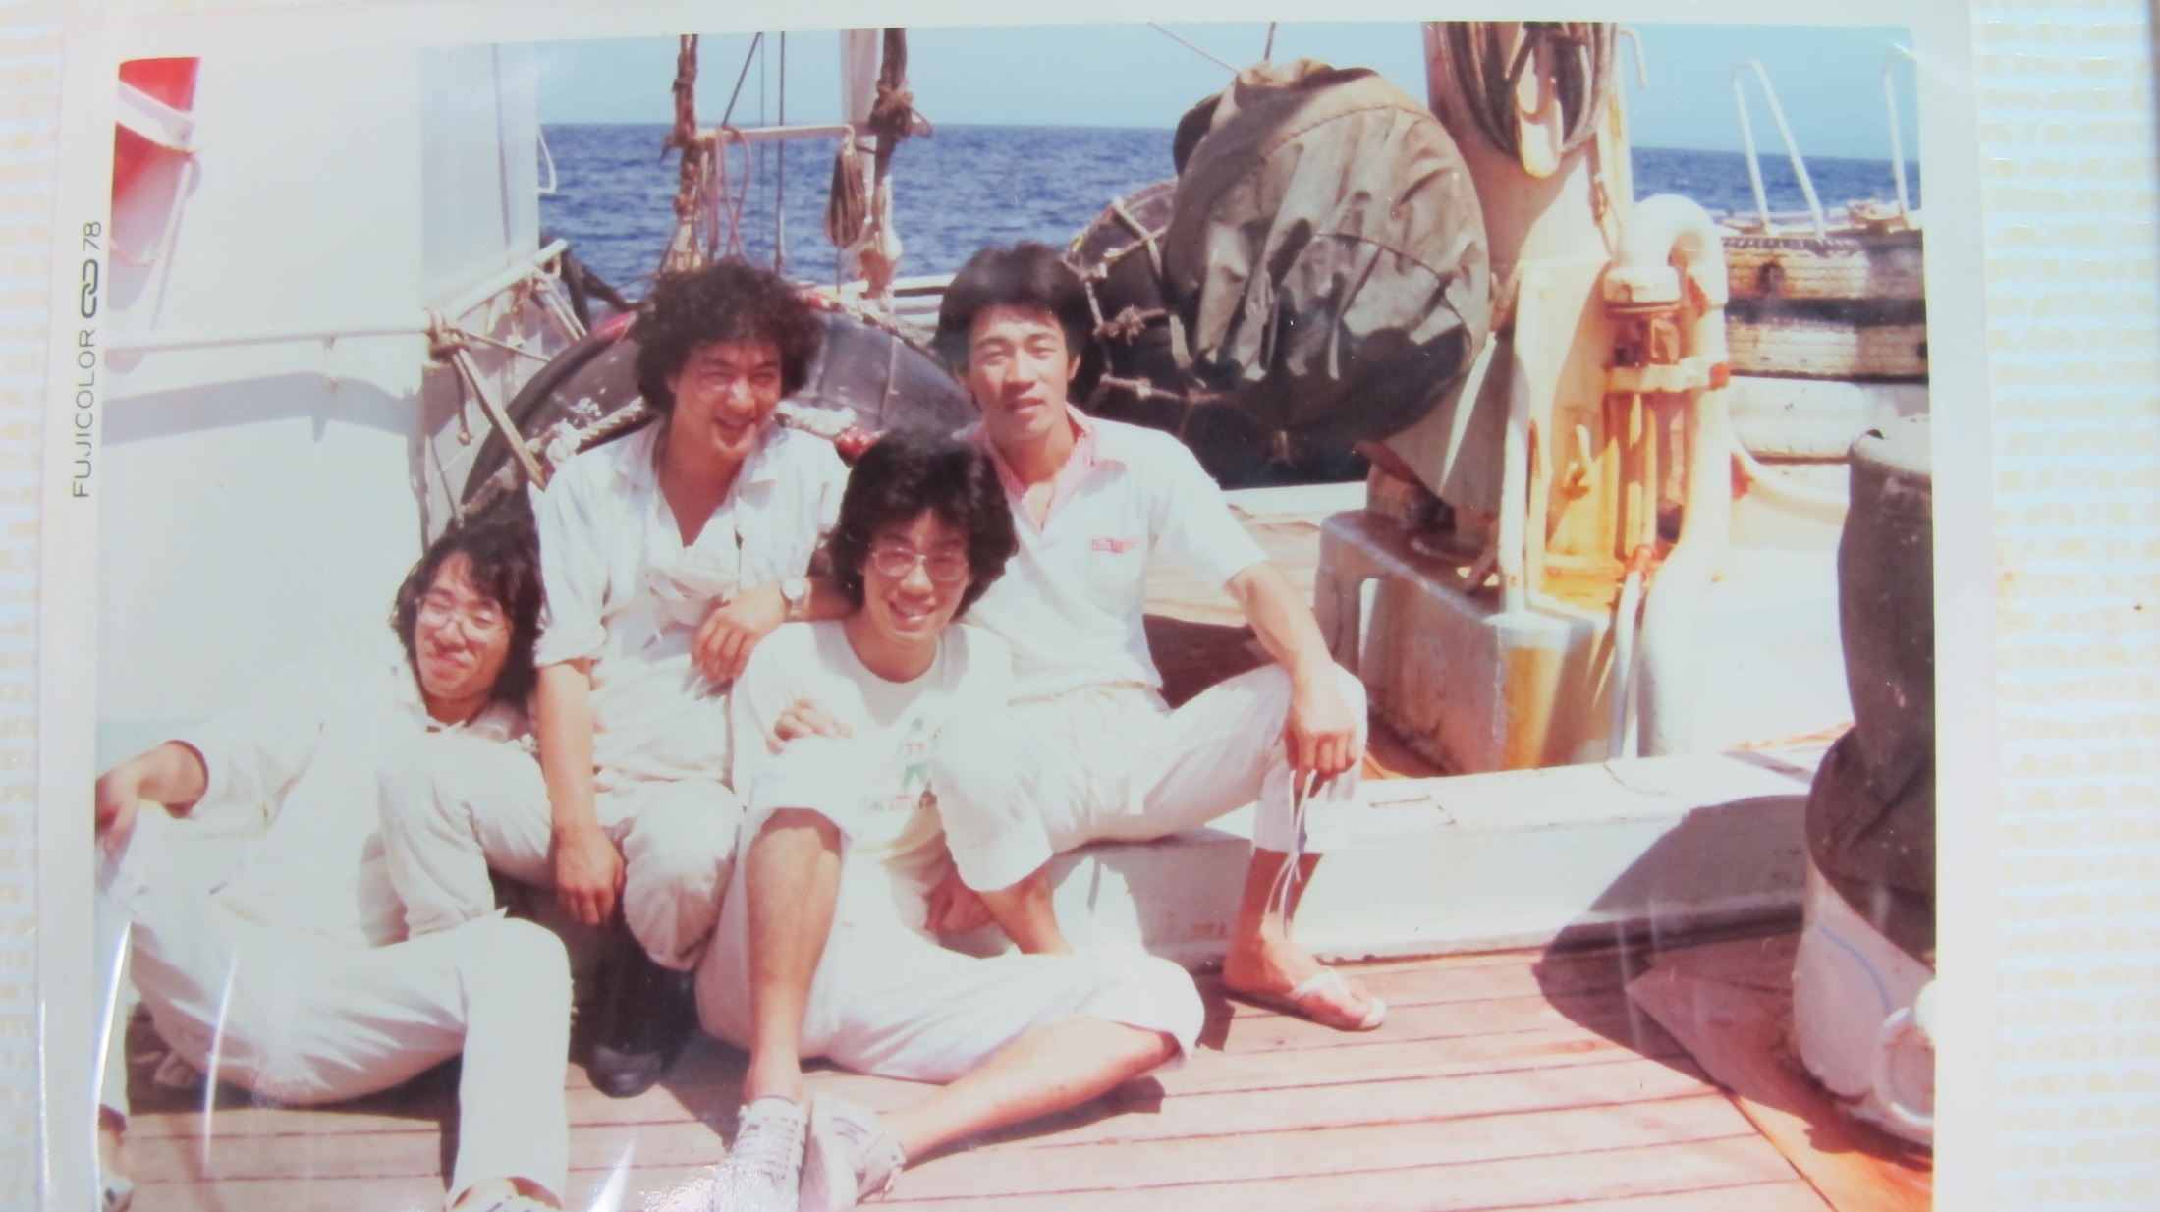
Editor: E.hayasaka

